Slide 1
TOURIVITY INC.
IMT 535 A – GROUP 2

Slide 2
TEAM MEMBERS
Hayagriv Sridharan – Account Director
Suryaprakash Vijayaraghavan – Project Manager
Elizabeth MacCready – UX Designer
Tejaswini Buche – Information Architect
Sriharsha Garuda – Developer
Vignesh Sivakumar - Tester

Slide 3
Topic Description
Novel, sophisticated, social, gamified activity based tourism application
No market offering for specific activity based tourism
Financially and socially independent audience
Enjoy bragging rights

Slide 4
Project Goals
Activity based tourism website
How they travel
Passion rather than location
Why they travel
Celebrate dual income, no kids demographic

Slide 5
Audience Definition
Final Target Audience: Dual Income No Kids Category
Demographics
30 – 50 Age group
Both employed
No Kids
Prefer shorter frequent vacations ( 1-2 weeks)

Slide 6
Audience Definition
Psychographics
Prefer thrill over cost
Group with like minded people
Venture outside comfort zone
Interact with locals
No bucket list yet!

Slide 7
Information Architecture Theory and Practice
Front-end
Don’t make me think
6-seconds rule
Clear visual hierarchy
Gestalt principles
User-centered design (breadcrumbs)

Slide 8
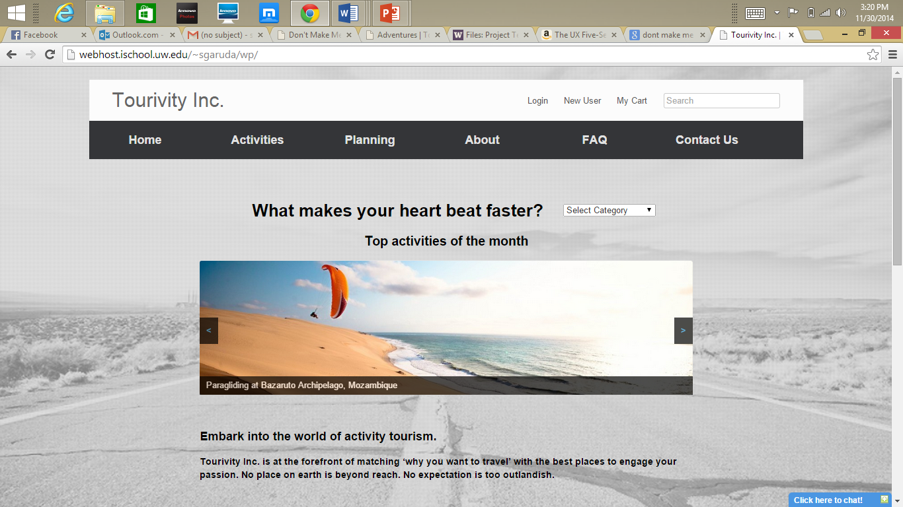
Visual Hierarchy V
Don’t make me think!
6 seconds rule

Slide 9
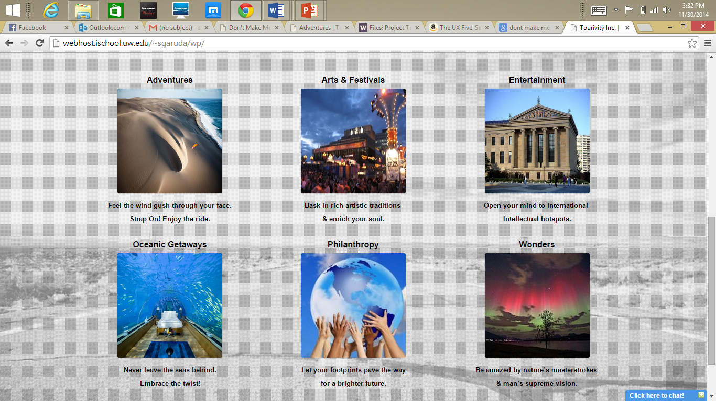
Gestalt principle

Slide 10
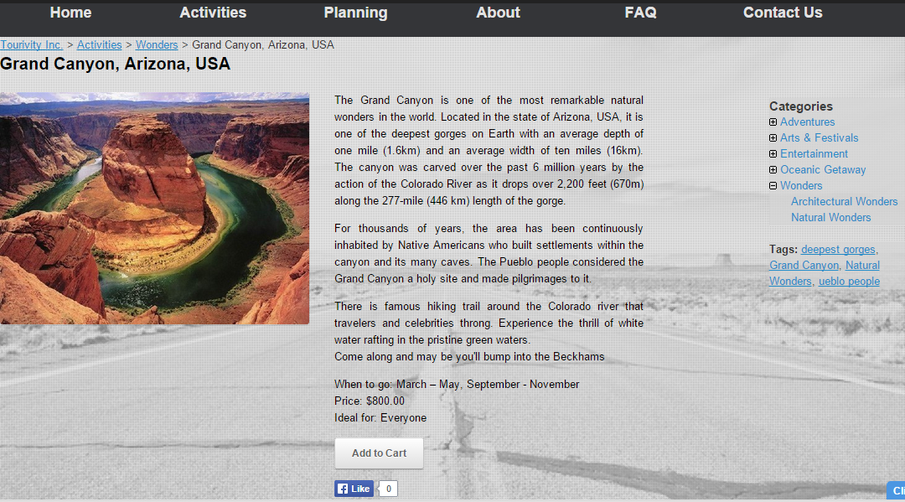
Breadcrumbs

Slide 11
Information Architecture Theory and Practice
Back end
Class inclusion relationships
Taxonomies
Descriptive tagging
Descriptive metadata used
Search strategy - Drill down approach
Content plan

Slide 12
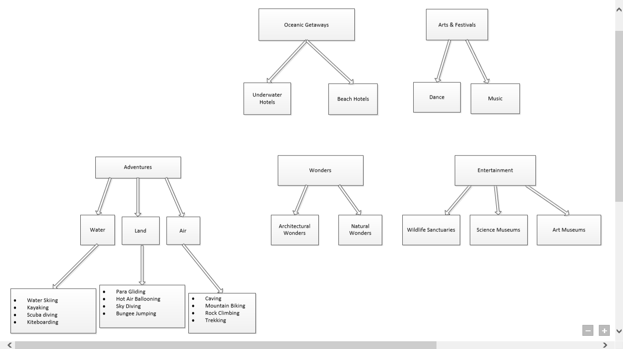
3-level categorization

Slide 13
Search strategy – drill down
Descriptive Tagging
Descriptive metadata

Slide 14
Passion
Instinct driven
PLANNED SERENDIPITY
Accidental discovery

Slide 15
Content Plan
Adventure Sports | Water Adventures | Water skiing | Sacramento, California Lake Havasu City, Arizona San Diego, California
 |  | Kayaking | Glacier Bay, Alaska Baja, California, Mexico Kadavu Island, Fiji
 |  | Scuba diving | Palancar Horseshoe Point Lobos Nakwakto Rapids
 |  | Kiteboarding | La Ventana, Baja California Nabq, Egypt Tarifa, Spain
 | Land adventures | Caving | Cango Caves, South Africa Puerto-Princesa Underground River Phong Nha Cave
 |  | Mountain biking | Hong Kong Cape Town Geneva
 |  | Rock climbing | Mount Khuiten Kilimanjaro The Andes
 |  | Trekking | GR20 Inca Trail Pays Dogon
 | Air adventures | Para gliding | Wengen, Canton of Bern, Switzerland Queenstown, Otago, New Zealand Castelluccio, Umbria
 |  | Hot air ballooning | Loire Valley Serengeti National Park Yarra Valley
 |  | Sky diving | Wollongong, Sydney, Australia Hawaiian Islands Le Marche, Italy
 |  | Bungee jumping | Kawarau Bridge The Nevis Victoria Falls Bridge

Slide 16
Site Structure Map
Home Page
Activities
About
Contact Us
Adventures
FAQ
Planning
Description
Purchase
Restaurents & Hotels
Arts & Festivals
Wonders
Entertainment
Air Adventures
Water Adventures
Land Adventures
Water Skiing
Kayaking
Scuba Diving
Kiteboarding
Paragliding
Hot air ballooning
Sky Diving
Bungee Jumping
Caving
Mountain Biking
Rock Climbing
Trekking
Underwater Hotels
Beach Hotels
Dance
Music
Architectural Wonders
Natural Wonders
Art museums
Science Museums
Wildlife sanctuaries
Profile

Slide 17
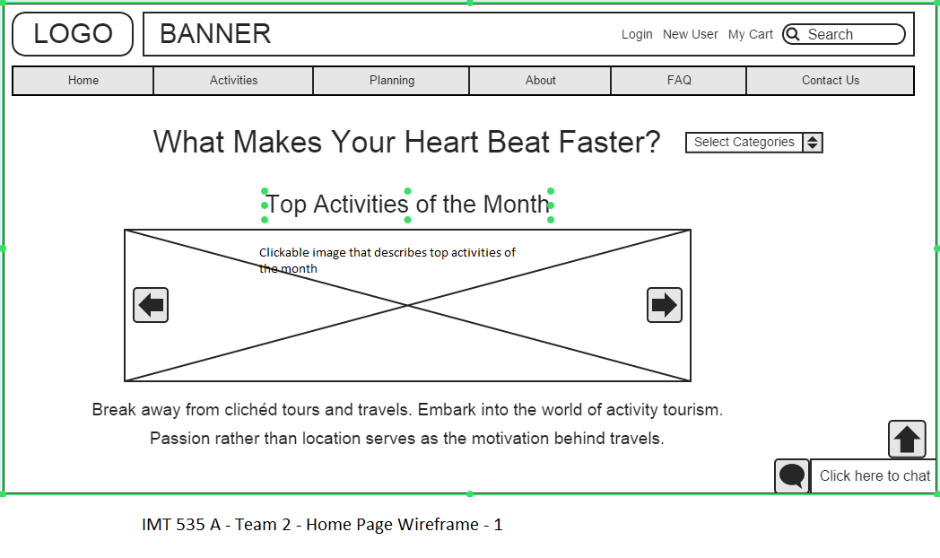
Wireframe – Home Page

Slide 18
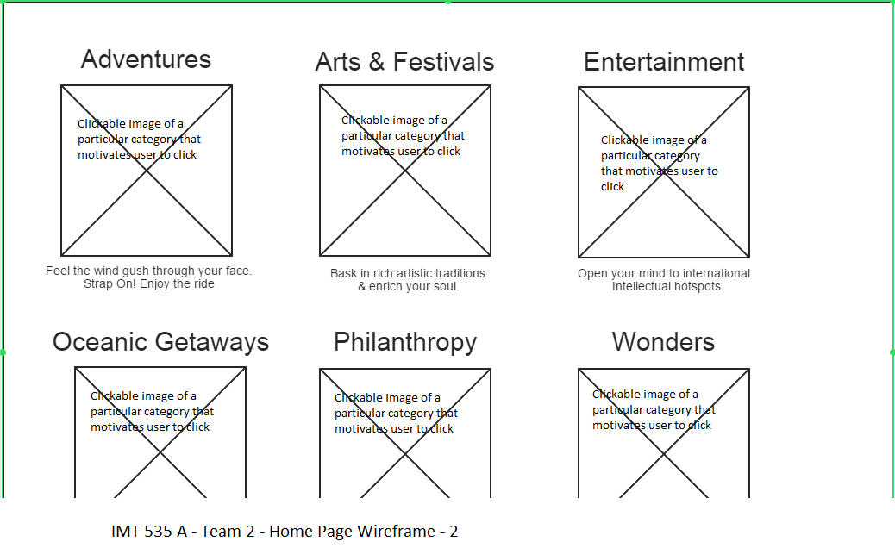
Wireframe – Home Page

Slide 19
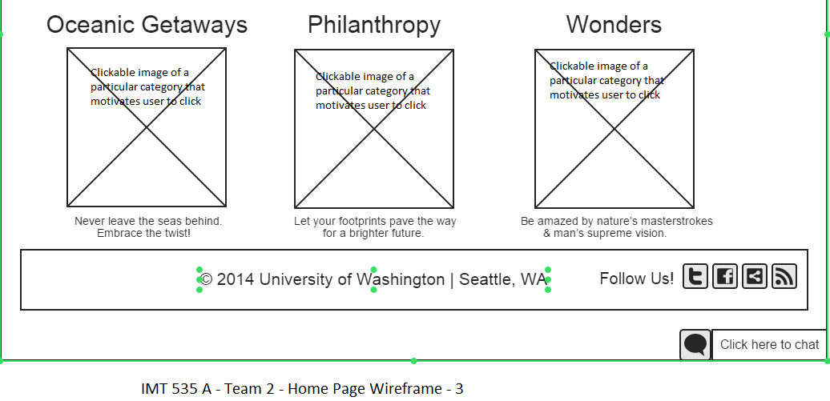
Wireframe – Home Page

Slide 20
Over to website demo
http://webhost.ischool.uw.edu/~sgaruda/wp/

Slide 21
Project Outcome
40% complete
Foundation ready
Audience engagement pending

Slide 22
Challenges
Functional challenges
Packaging activities
Absence of content manager
Volume of content
Provide real time support

Slide 23
Challenges
Technical challenges
Responsive web design
Development issues
Dependency on plugins

Slide 24
Phase 2 plans
Improve customer engagement
Planning and customization
Improved “shopping” experience
Faceted search
Gamification

Slide 25
Thank you!

